Slide 1



Vertical Slice Architecture
Jimmy Bogard
@jbogard
github.com/jbogard
jimmybogard.com

Slide 2


Slide 3
Inmates and asylums
ASPX
4 screens
Basic workflow
Role-based security
20K LoC
2 solutions, 12 projects
Code-Behind
ServiceProxy
WCF Service Proxy
WCF Service
BAL
DAL
Stored Procedure

Slide 4
Traditional n-tier
UI Layer
Business Logic Layer
Data Access Layer
Database

Slide 5
“DDD”-style n-tier
UI Layer
Services
Domain
Repository

Slide 6
Organizing by layer
Person.cs
PersonController.cs
PersonService.cs
PersonRepository.cs

Slide 7
PersonController
StudentController
Index
Edit
Create
Search
Enroll
Create
PersonService
StudentService
Index
Edit
Create
Search
Enroll
Create
PersonRepository
StudentRepository
Find
Get
Save
Find
Get
Save

Slide 8
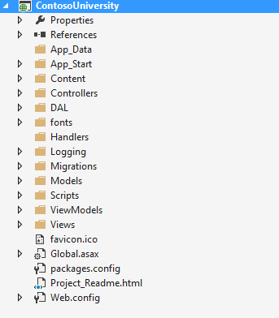
Areas of change

Slide 9
Axes of change
View Unapproved Invoices
Approve Invoice
Reject Invoice
UI Layer
Domain Objects
Repository
Database

Slide 10
Vertical Slice Architecture Model and organize application architecture around axes of change, vertical slices

Slide 11
Vertical Slices

Slide 12
Move code to single place

Slide 13
Move service methods to classes
Invoice Service
void Approve()
ApproveInvoice {}
void Reject()
RejectInvoice {}
void Flag()
FlagInvoice {}

Slide 14
Modeling requests
Input
Request Handler
Output

Slide 15
Request/Response with MediatR
IRequest<T>
IRequest
Handler<T>
T
Task<TResponse> Handle(
TRequest request) {
}

Slide 16
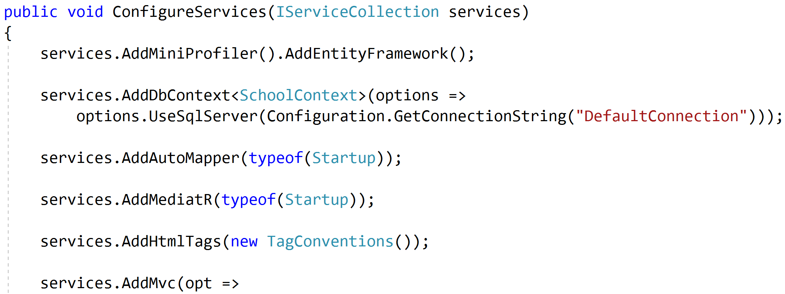
Registering MediatR

Slide 17
Commands and Queries
Web App
GET
Query
Handler
Response
Query
POST
Command
Handler
Response
Command

Slide 18
One model in, one model out
Query
Handler
Response
Command
Handler
Response

Slide 19
Complete encapsulation
Request
Response

Slide 20
Modeling Queries
Query
Handler
Response

Slide 21
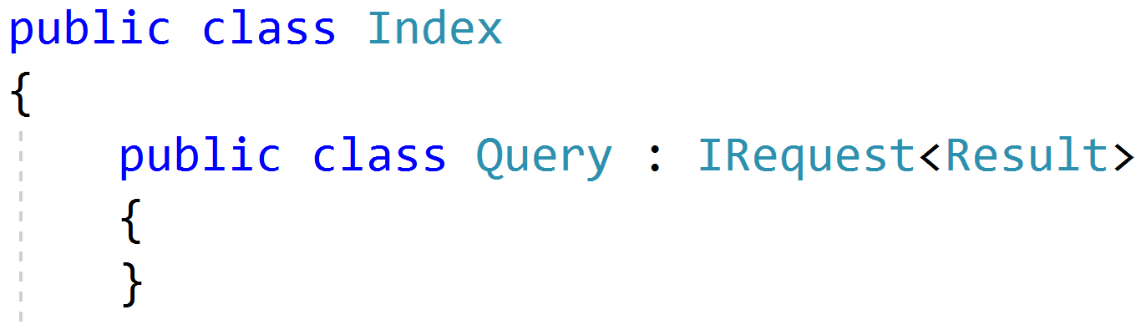
Simple Queries

Slide 22
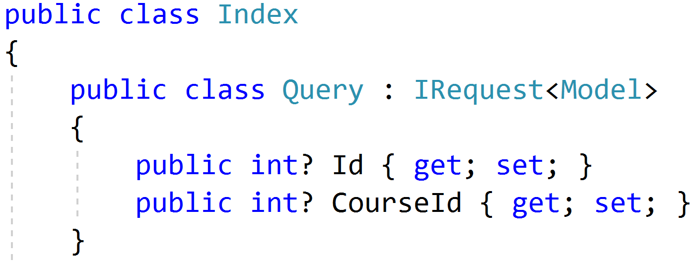
Parameterized Queries

Slide 23
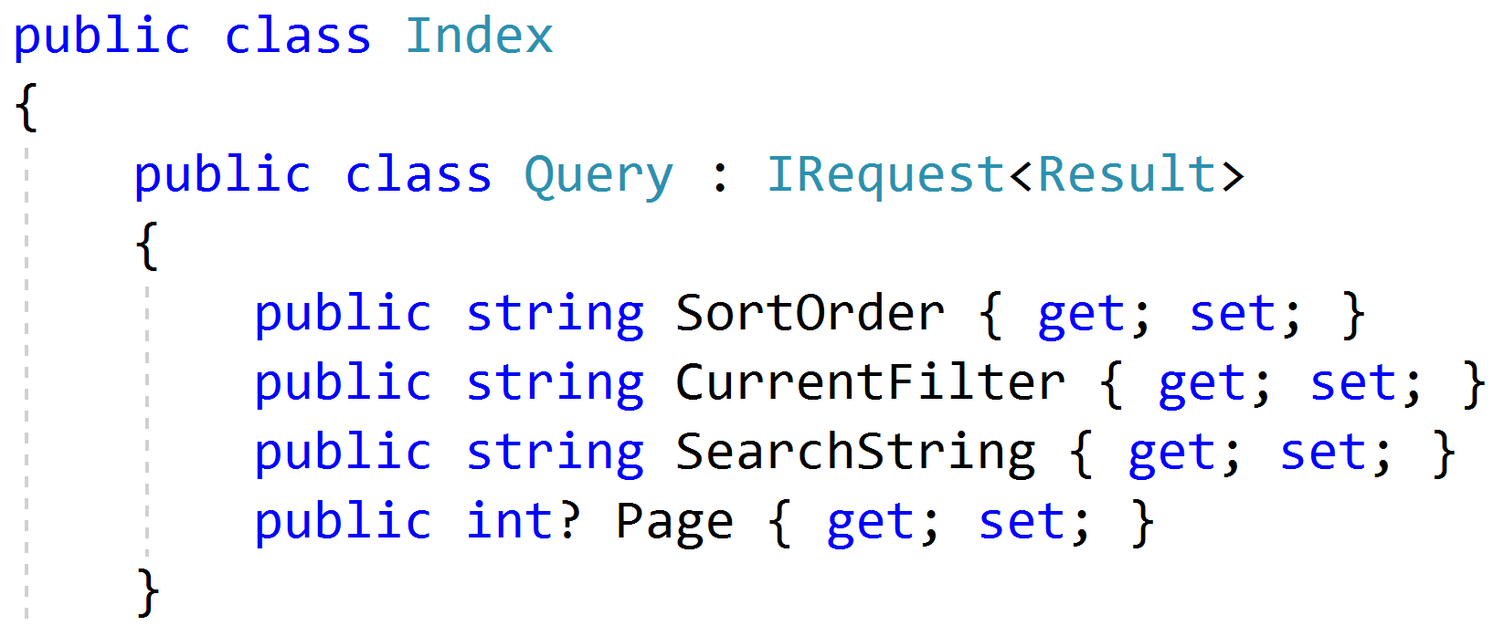
Paging/Sorting/Filtering

Slide 24
Modeling Responses
Query
Handler
Response
View

Slide 25
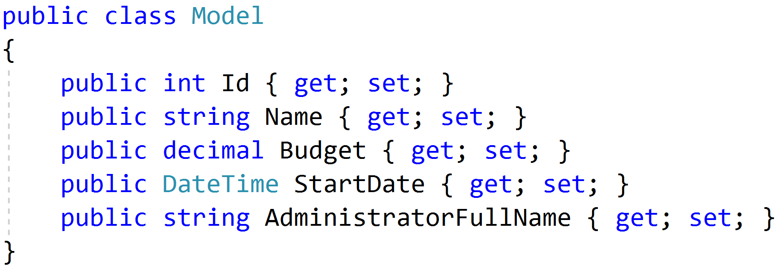
Simple Response

Slide 26
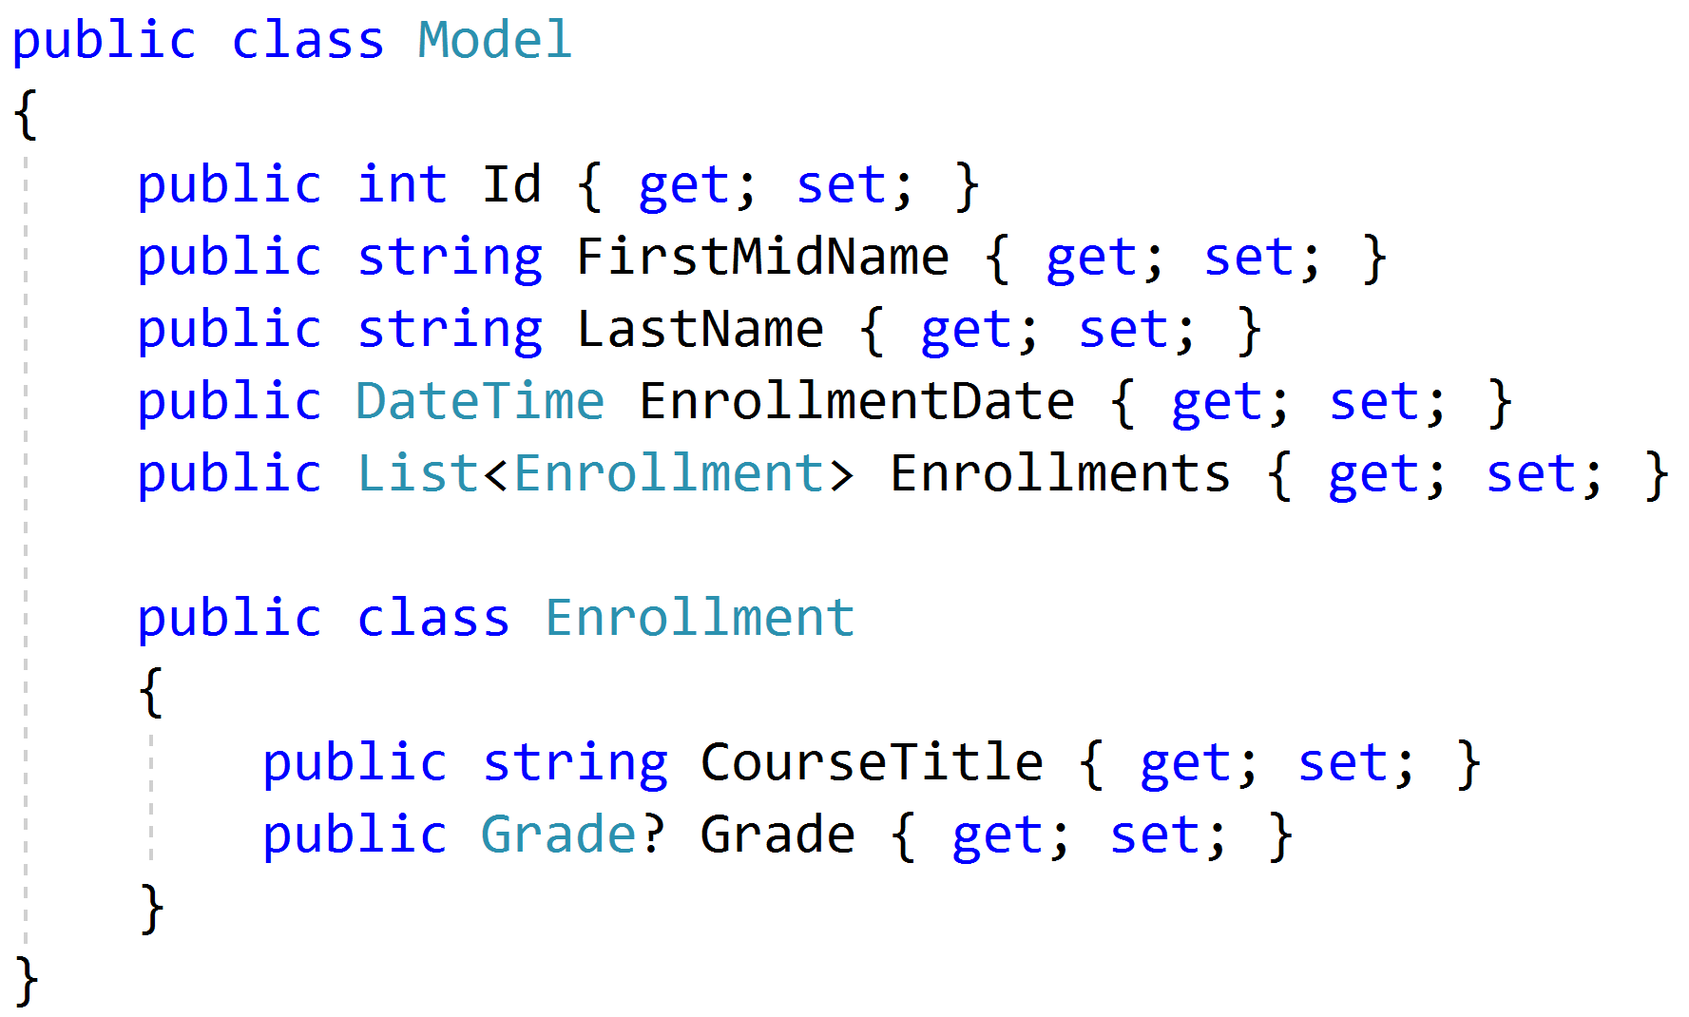
Complex Response

Slide 27
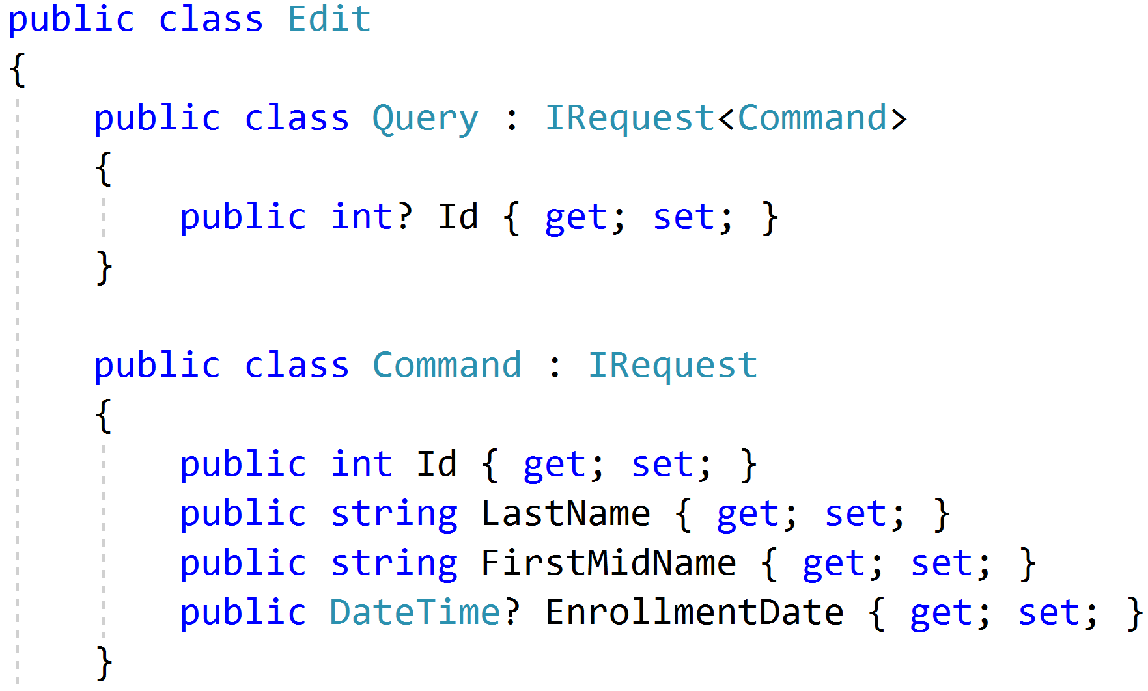
Command/Query Duality

Slide 28
Modeling Commands
Command
Handler
Response

Slide 29
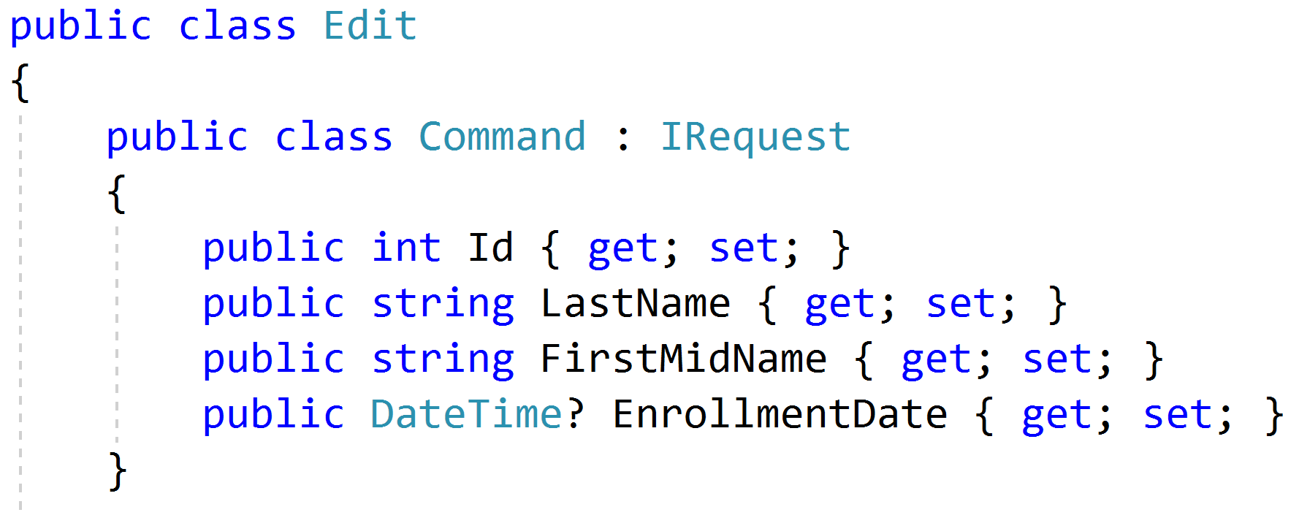
Simple Commands

Slide 30
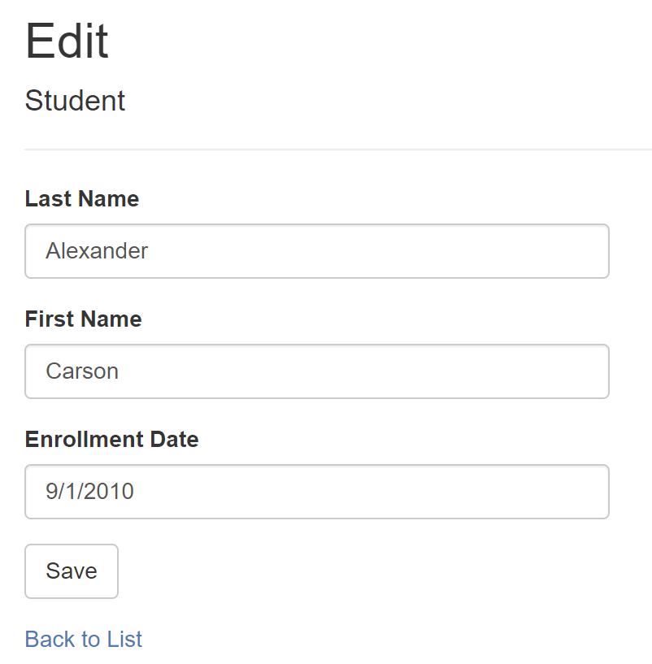
Model-Bound Types

Slide 31
Task-Based UIs
Transfer
Student Details
Request
Handler
Response
Transfer
Correct
Schedule
…
…
…
…
…
…
…
Correct
Request
Handler
Response
Schedule
Request
Handler
Response

Slide 32
Modeling Command Responses
Command
Handler
Response

Slide 33
Void Response
Command
Handler
IRequest

Slide 34
Command Result Response
Command
Handler
T
IRequest<T>

Slide 35
Success/Fail
Command
Handler
true/
false
IRequest<bool>

Slide 36
Creation
Create
Handler
Id
IRequest<Guid>
302 Found
/orders/081bcba7-89ff-4a41-af90-ded095160b99

Slide 37
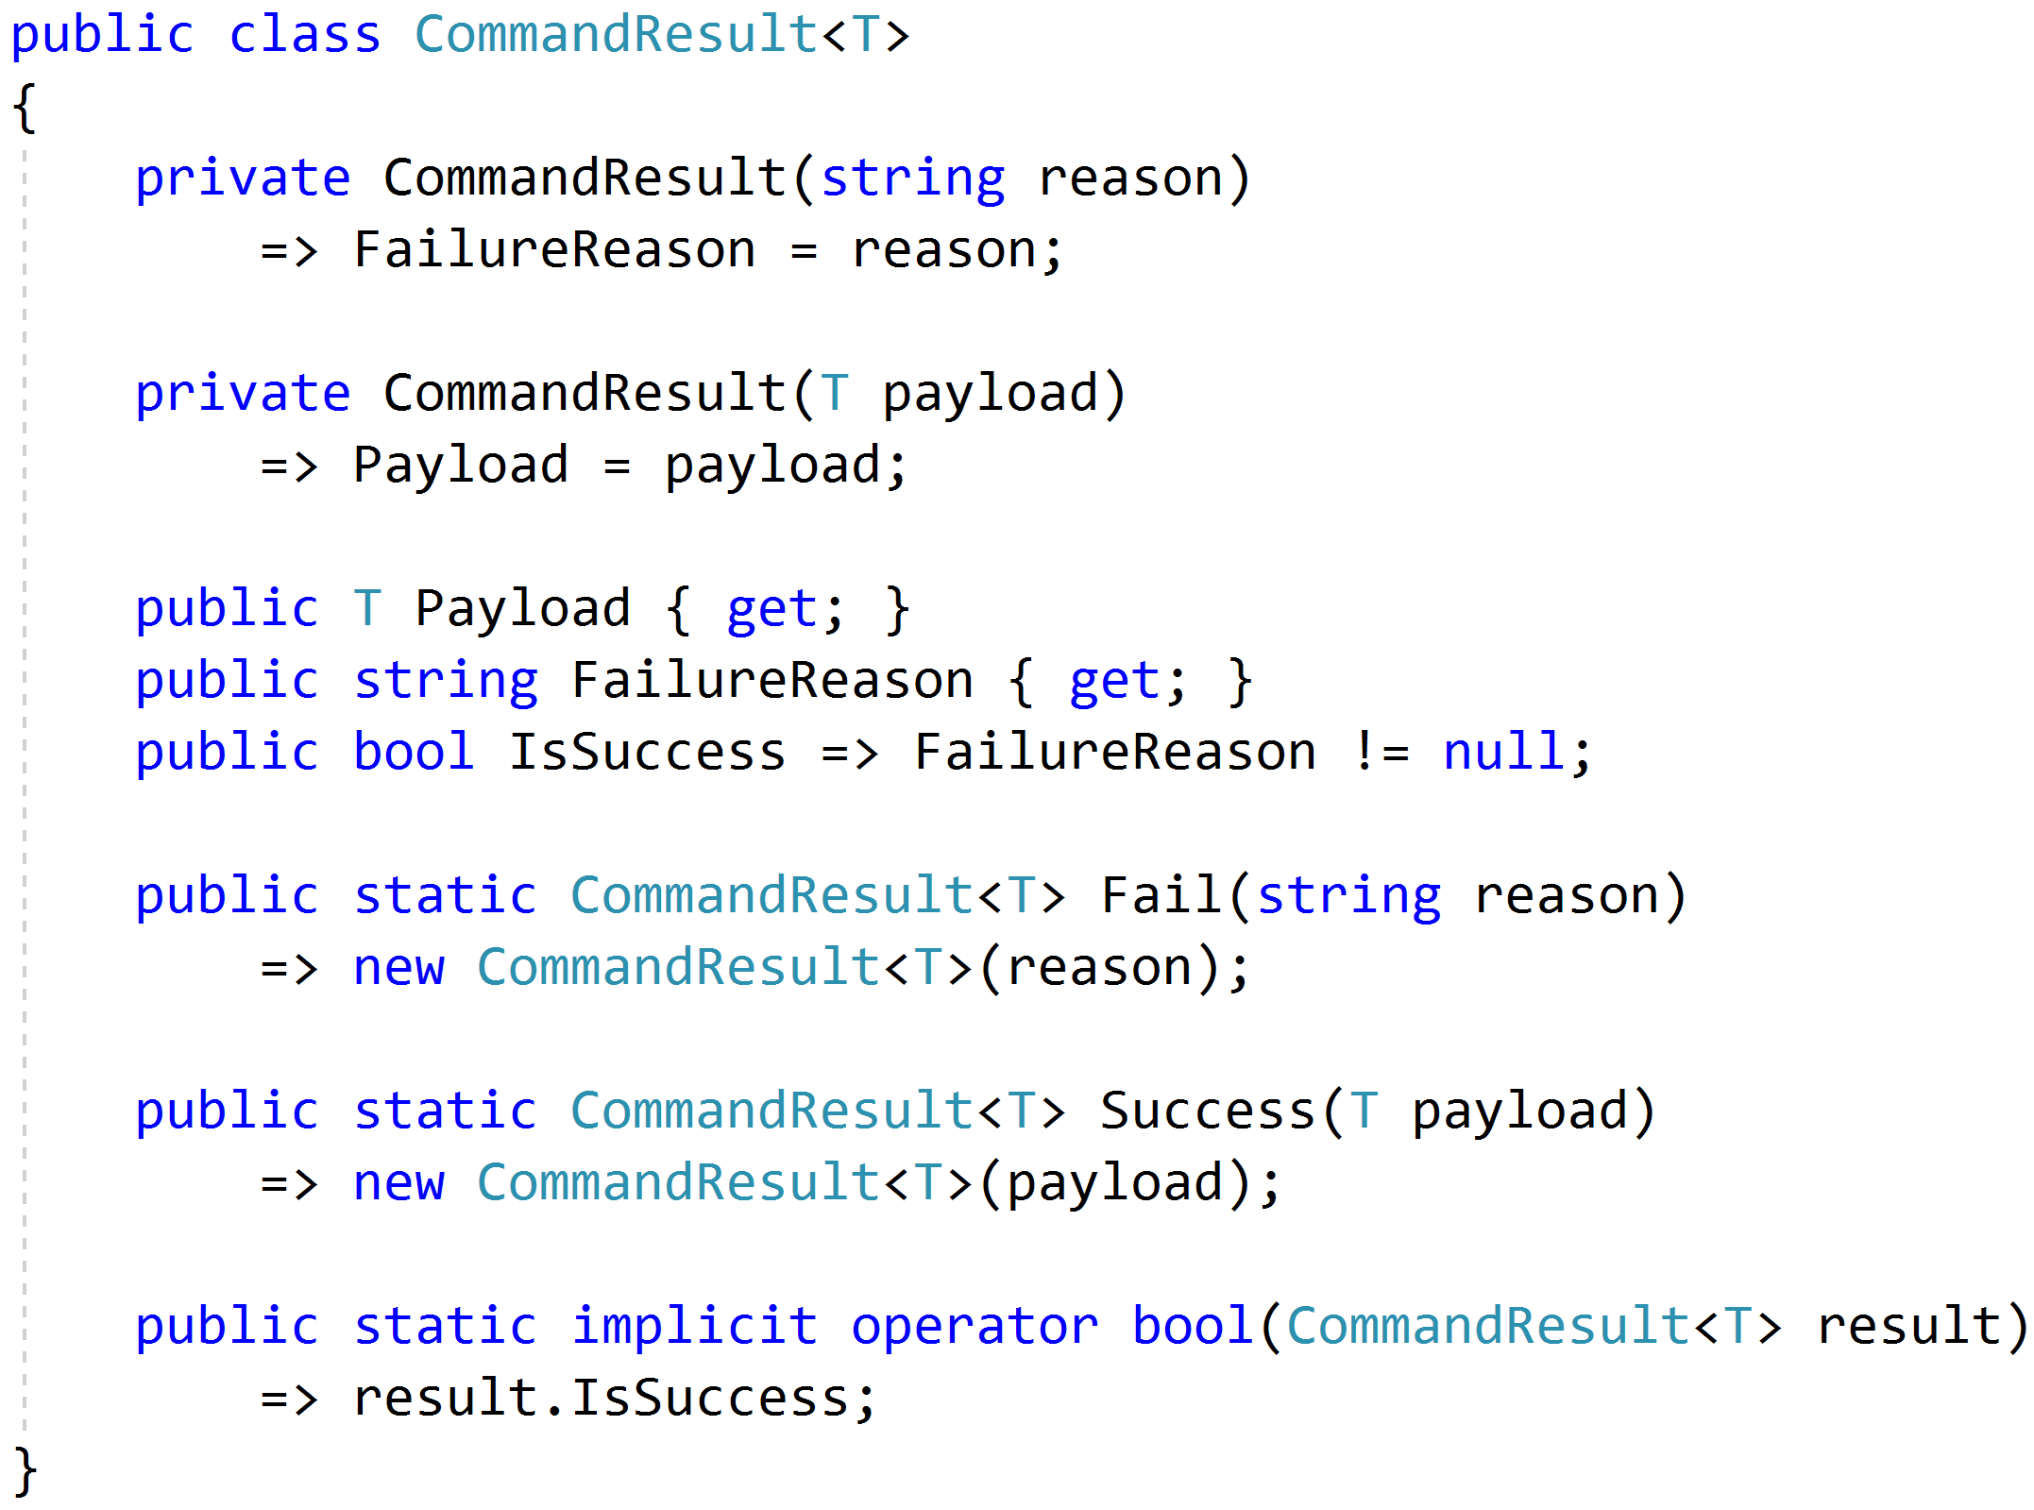
Complex Response

Slide 38
Modeling Query Handlers
Query
Handler
Response

Slide 39
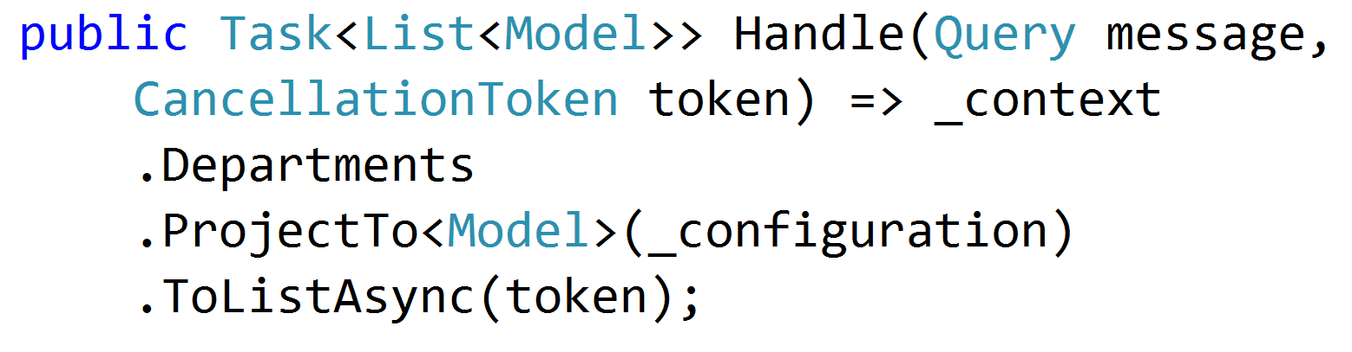
Simple AutoMapper Projections

Slide 40
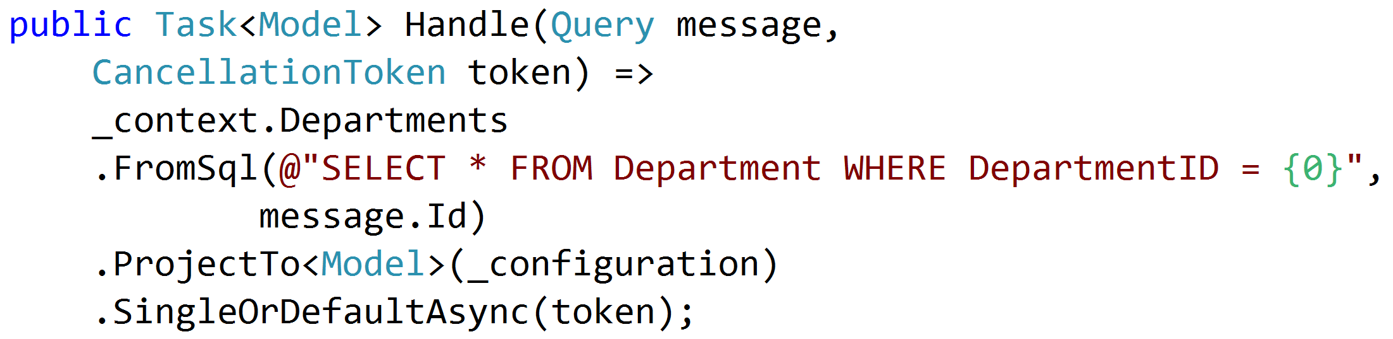
SQL Projections

Slide 41
Encapsulated Logic
Query
ORM
Response
Query
MicroORM
Response
Query
HttpClient
Response
Query
MeatGrinder
Response

Slide 42
Duplicate Logic
Query
Handler
Response
Common
Query
Handler
Response
Common

Slide 43
Refactor
Query
Handler
Response
Class?
Function?
Extension Method?
Common
Query
Handler
Response

Slide 44
Command Handlers
Command
Handler
Response

Slide 45
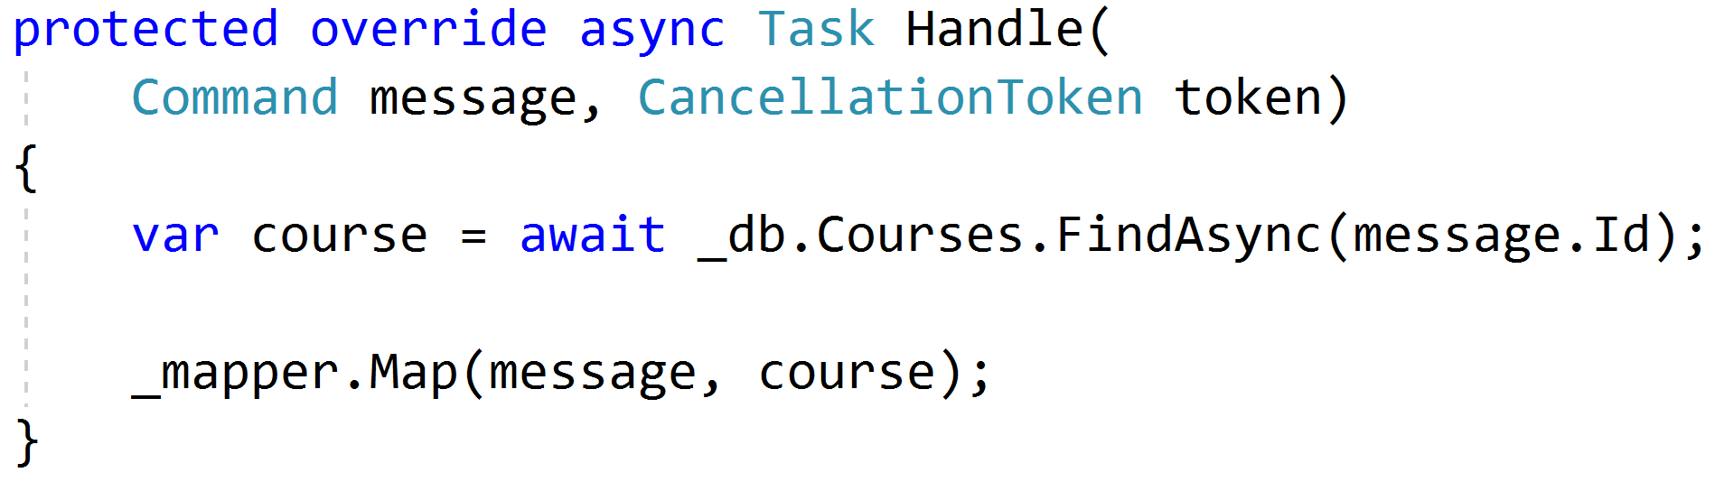
Procedural Beginnings

Slide 46
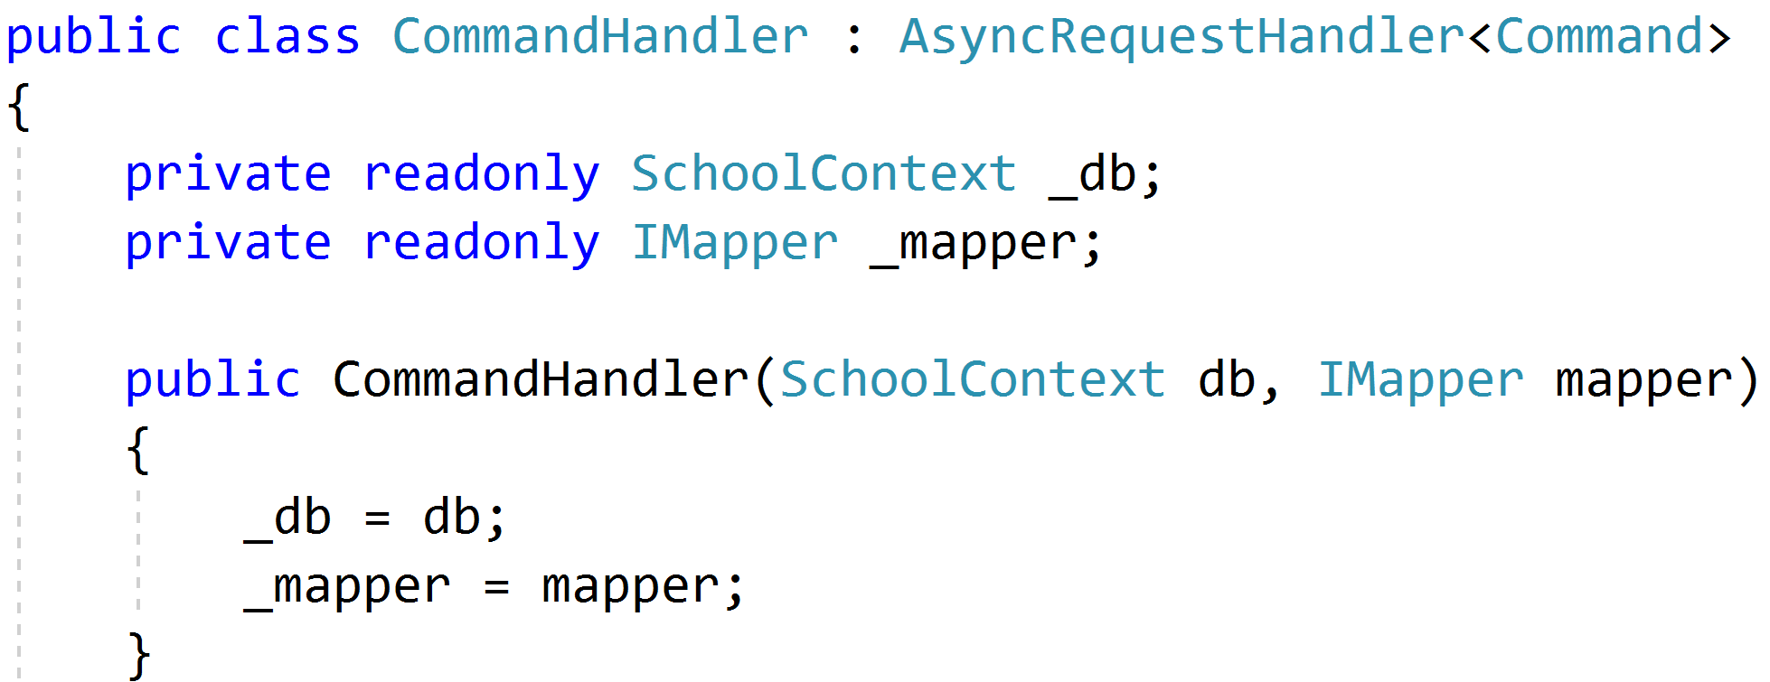
DI with no abstractions

Slide 47
Complexity?

Slide 48
Don't Panic!

Slide 49
Red
Green
Refactor

Slide 50

Code Smells
Large Class
Extract Class
Extract Subclass
Extract Interface
Replace Method
with Method Object
Compose Method
Extract Method
Move Method
Long Method

Slide 51

Behavioral Smells
Combinatorial Explosion
Conditional Complexity
Feature Envy
Inappropriate Intimacy
Duplicated Code

Slide 52
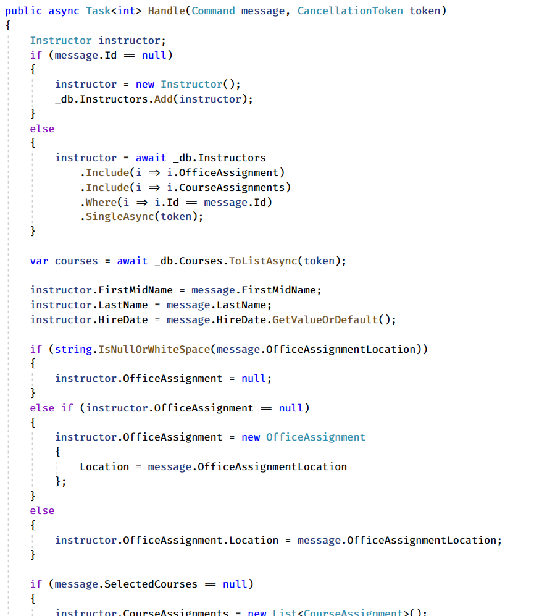
Large Method!
Request
Handler
Domain
Response

Slide 53
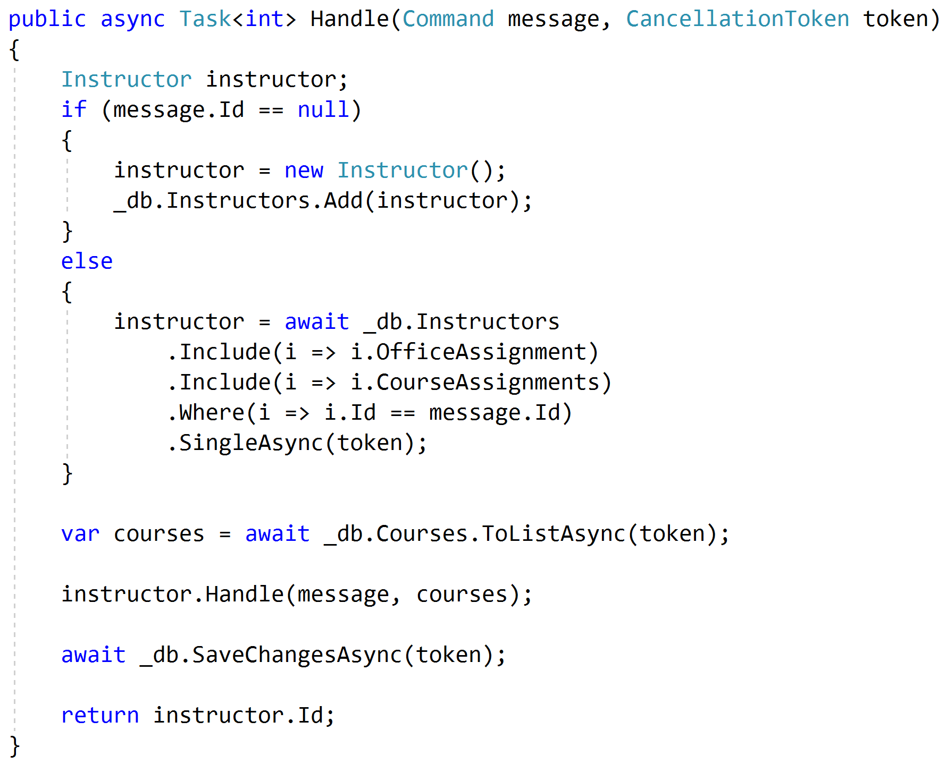
Push Behavior Down
Request
Handler
Domain
Response

Slide 54
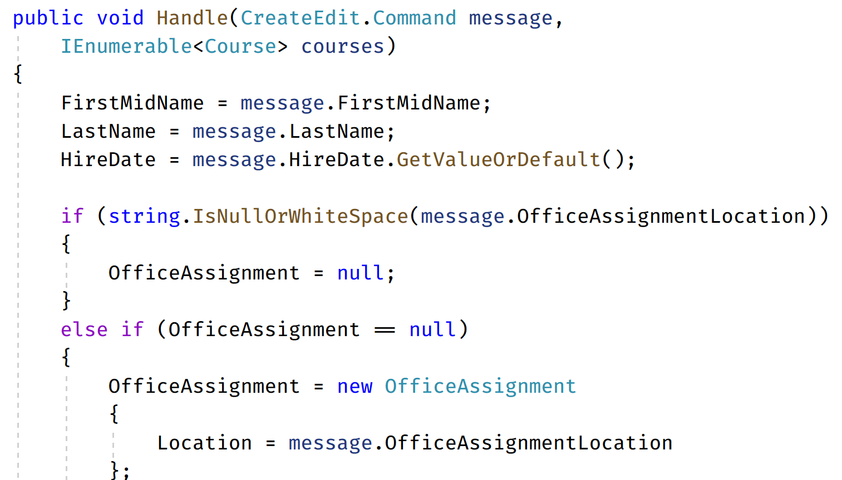
Code Smells (again)
Request
Handler
Domain
Response

Slide 55
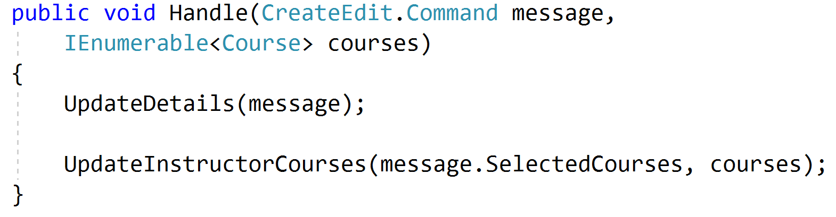
Refactored Toward Encapsulated Domain
Request
Handler
Domain
Response

Slide 56
Validation?

Slide 57
Validation Scopes
Command Validation
Domain Model
Request Validation
Request
Database
External Models

Slide 58
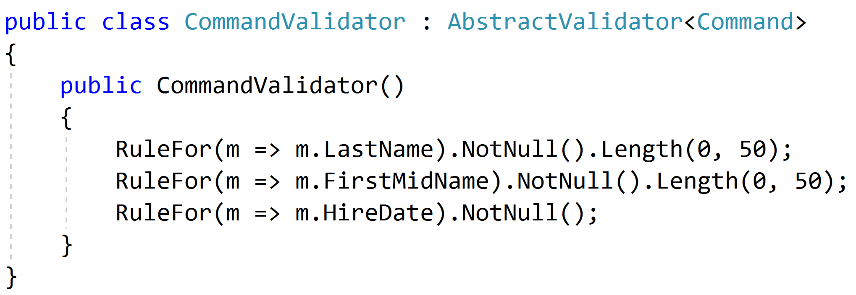
Request Validation

Slide 59
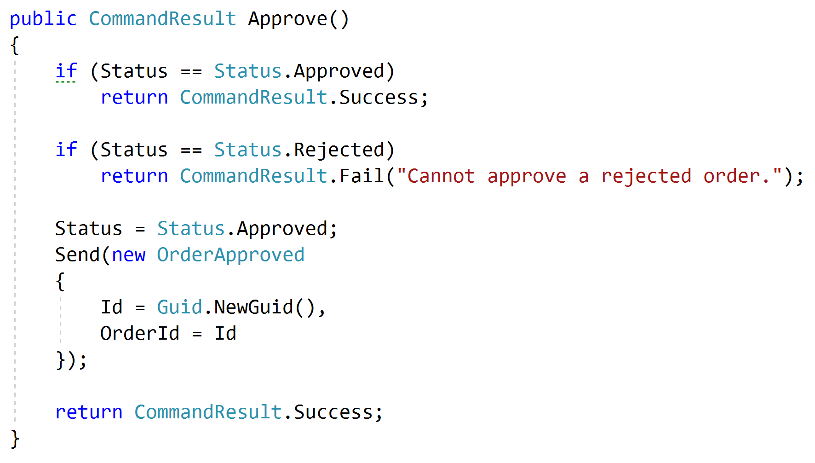
Domain Validation
Request
Handler
Domain + Validation
Response

Slide 60
Representations
Query
Handler
Response
????

Slide 61
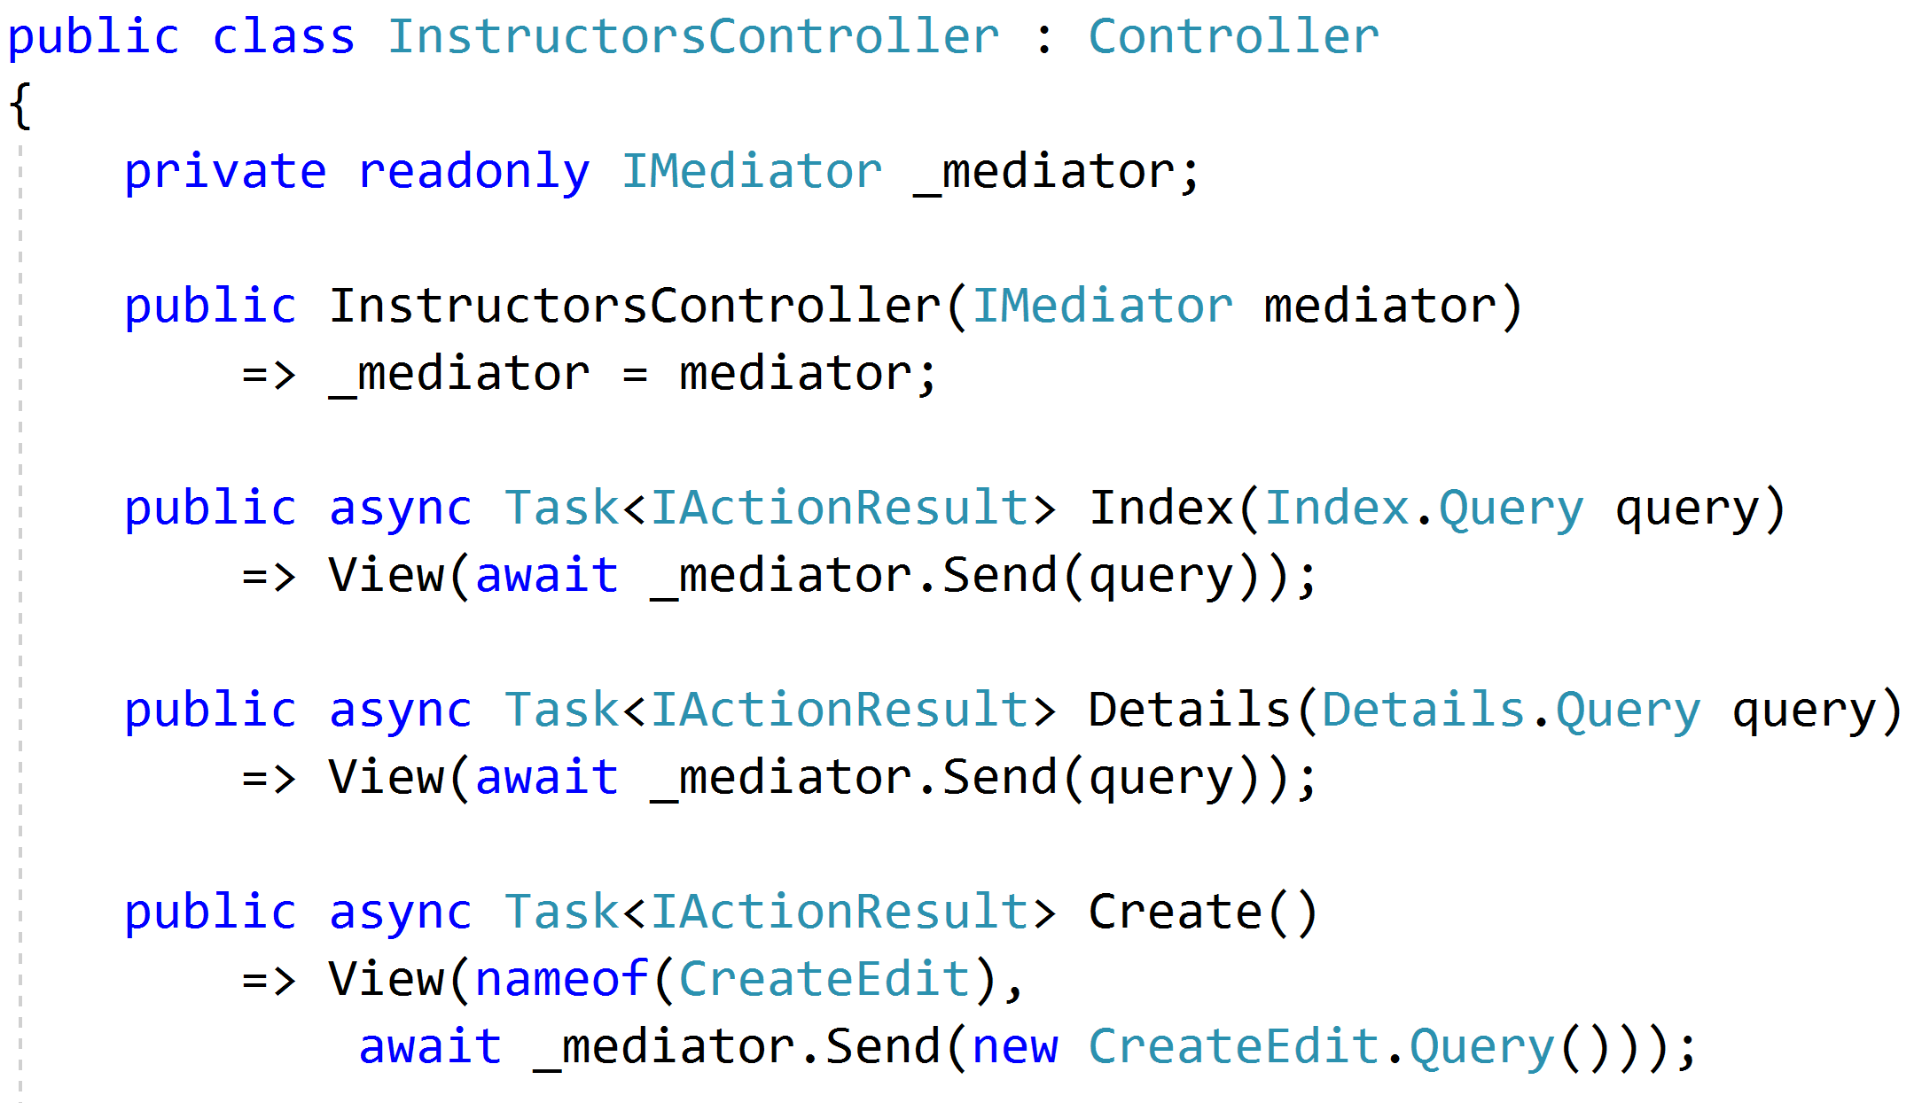
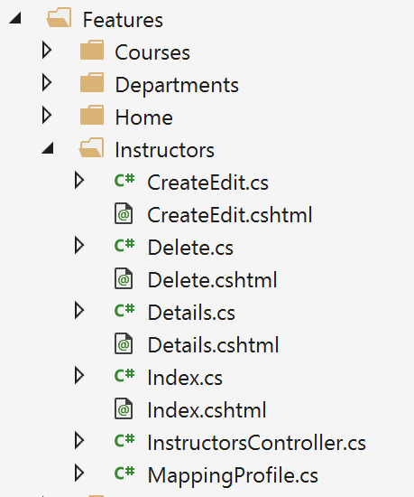
Controllers as routes

Slide 62
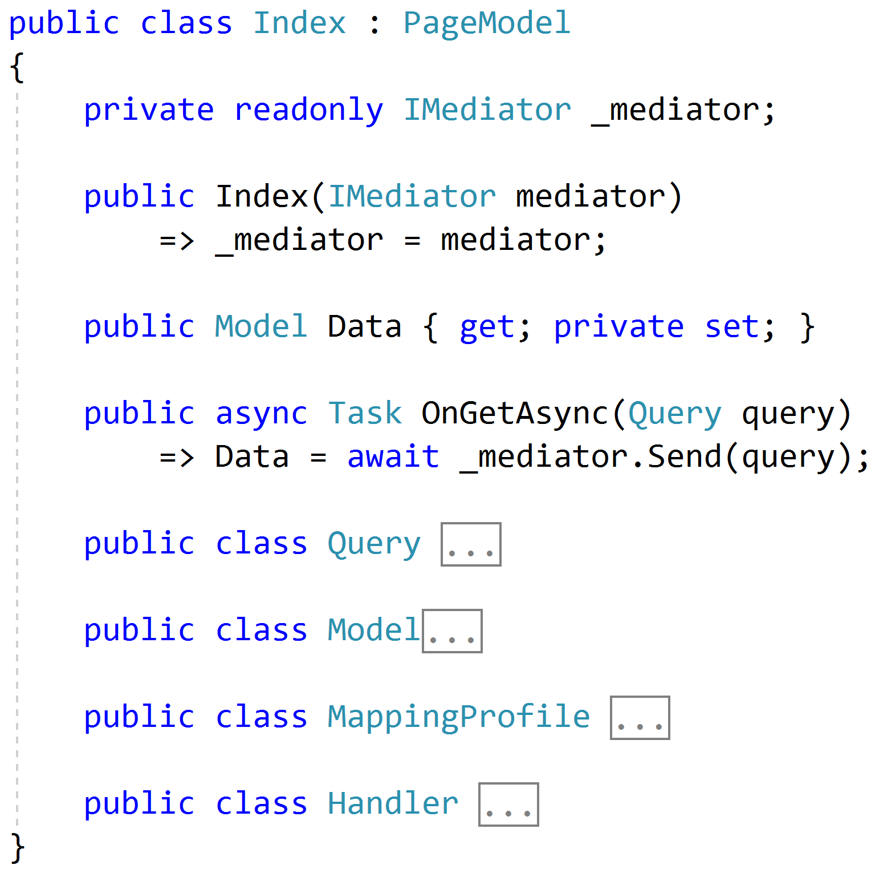
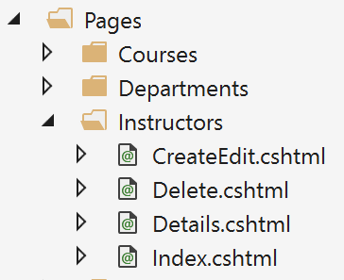
Razor Pages

Slide 63
Web APIs
/order/approve
Handler
/order/reject
Handler
Order json
/order/hold
Handler
/order/cancel
Handler
SPA

Slide 64
Cross-Cutting Concerns
Duplication
Request
Handler
Response

Slide 65
Pipeline Behavior (Decorator)
Pipeline Behavior
Request
Handler
Response

Slide 66
Stackable Decorators
Pipeline Behavior
Pipeline Behavior
Pipeline Behavior
Handler

Slide 67
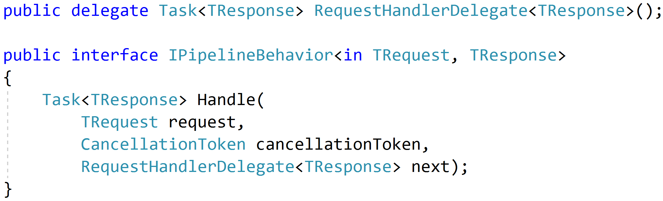
Think: Action Filters

Slide 68
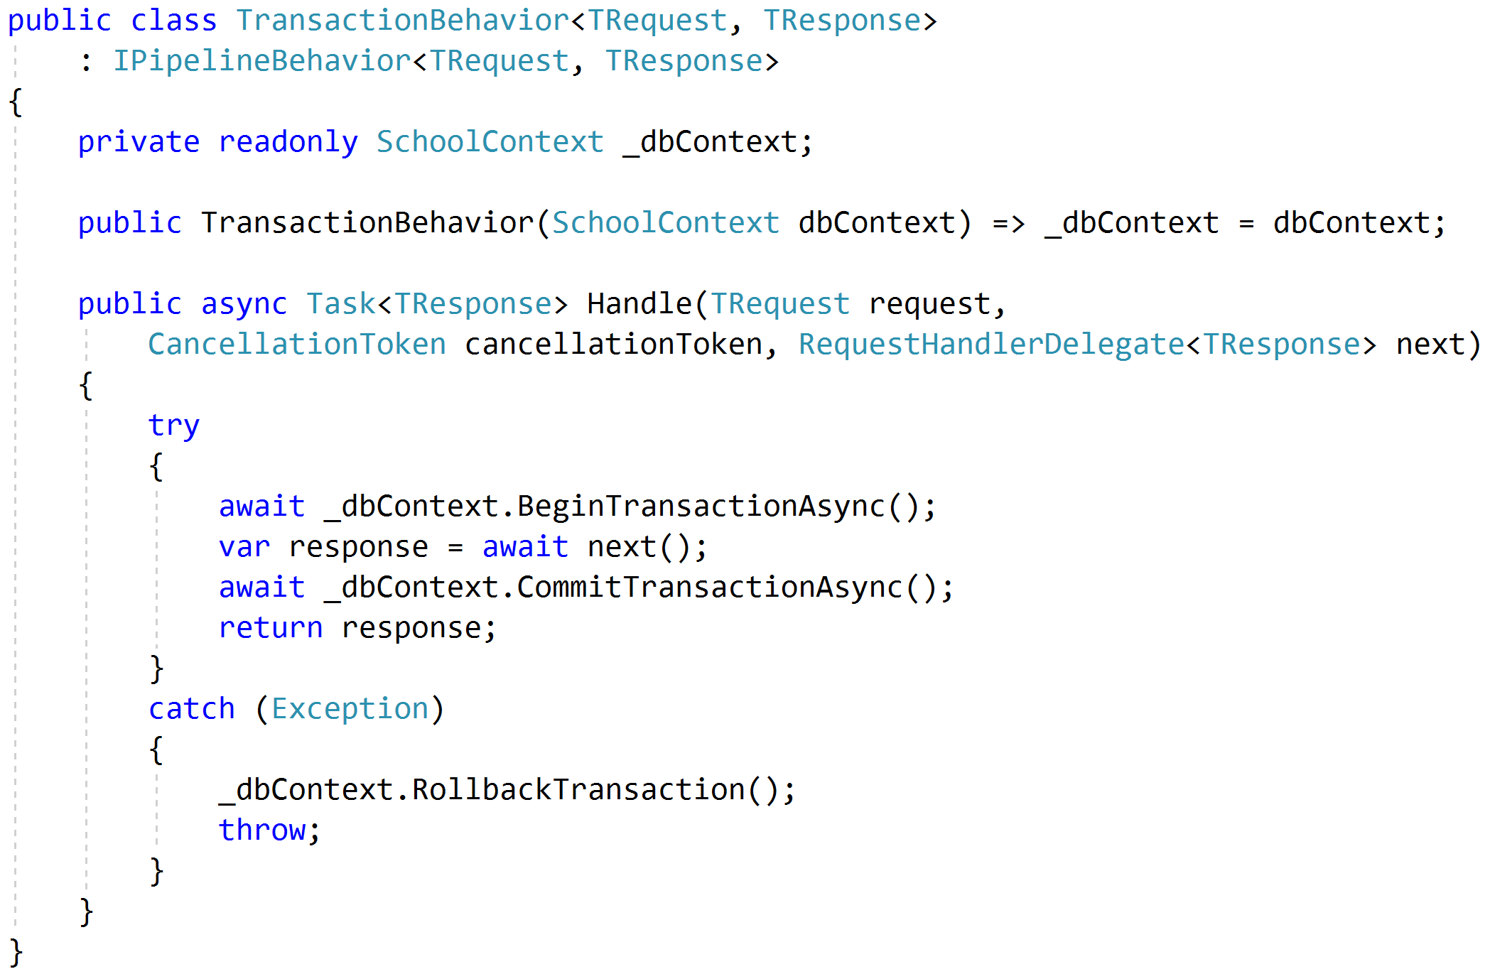
Transactions

Slide 69
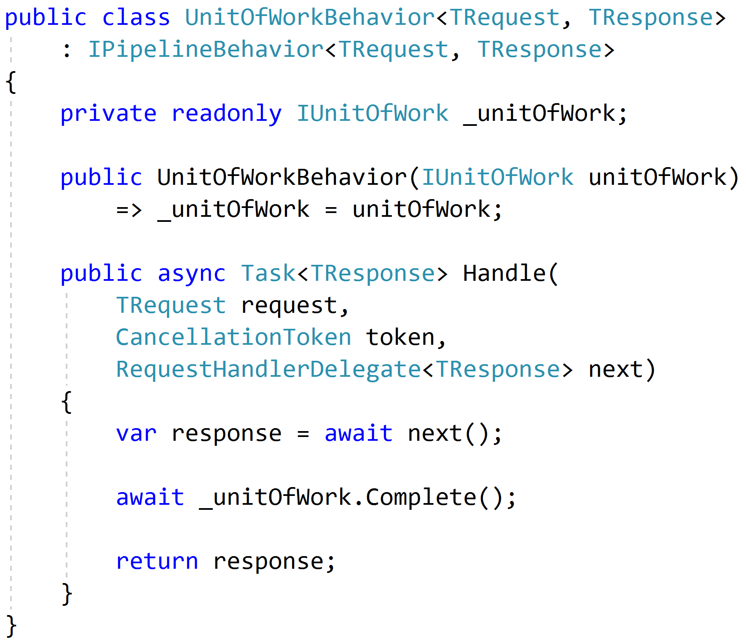
Unit of Work

Slide 70
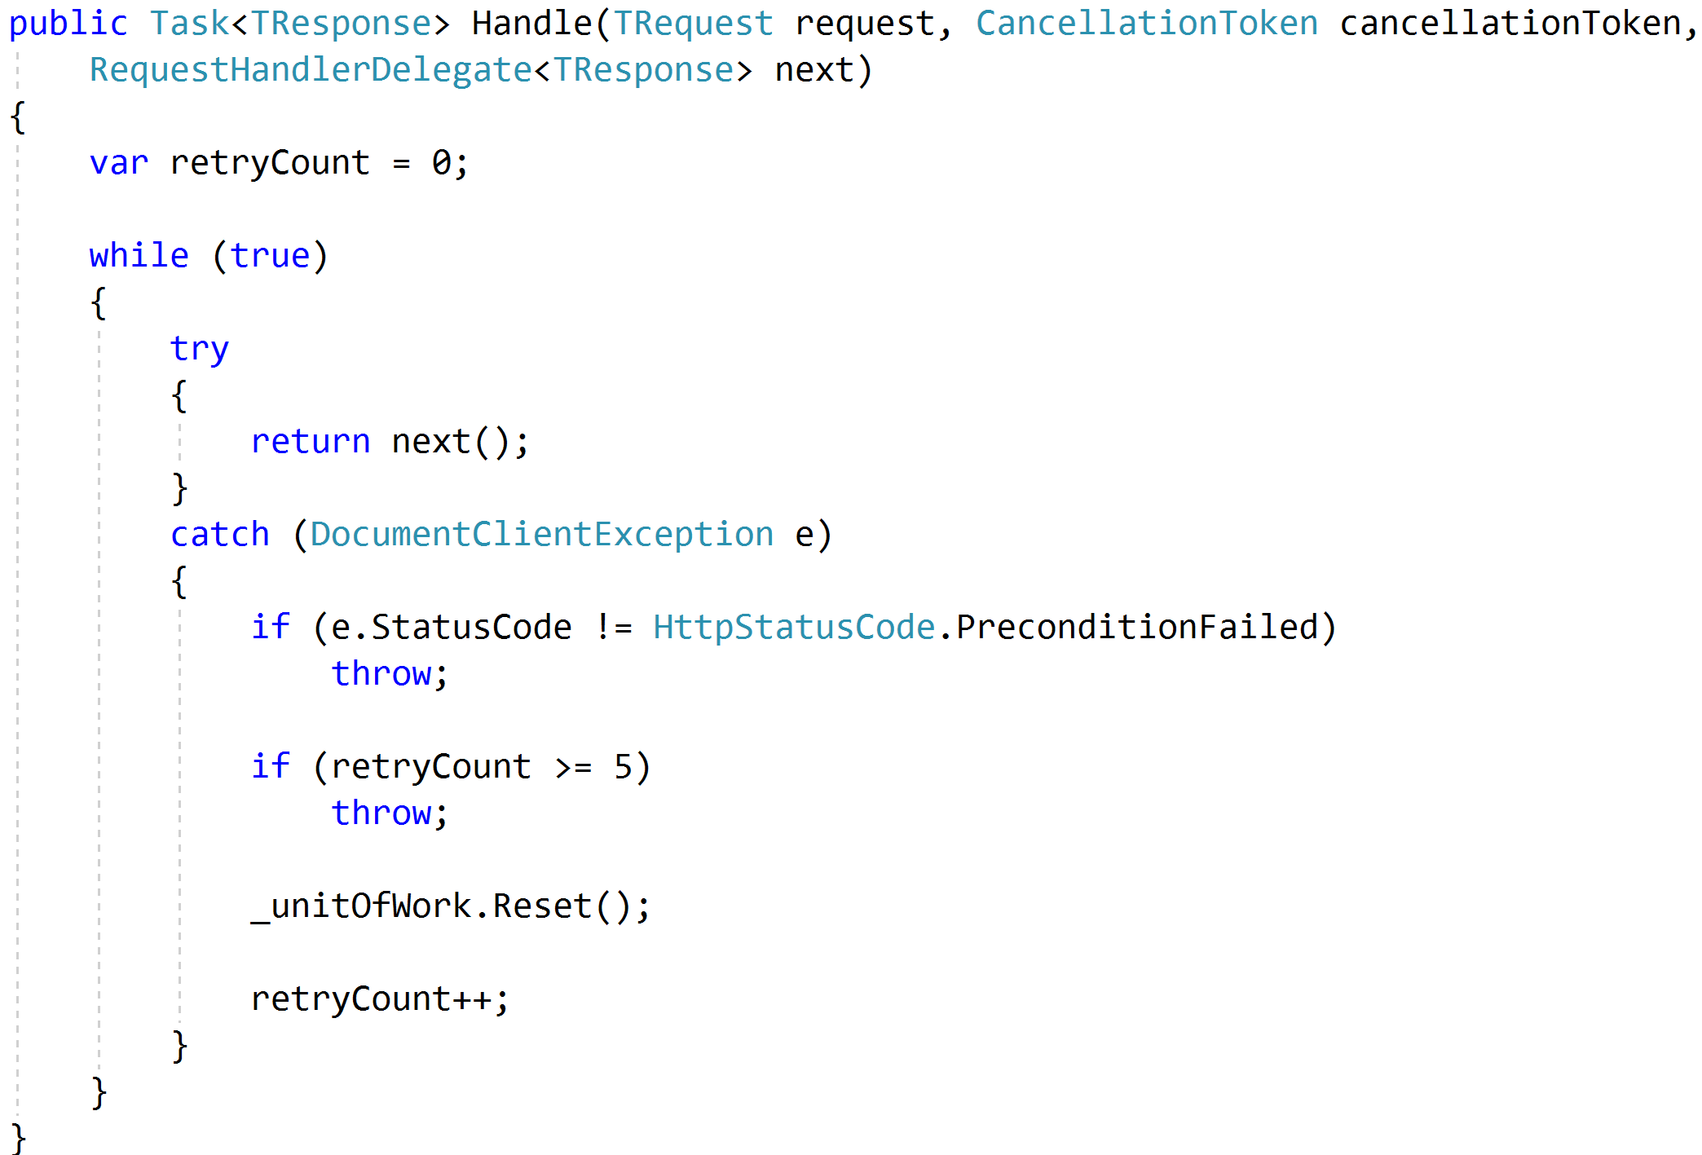
Concurrency and Retries

Slide 71
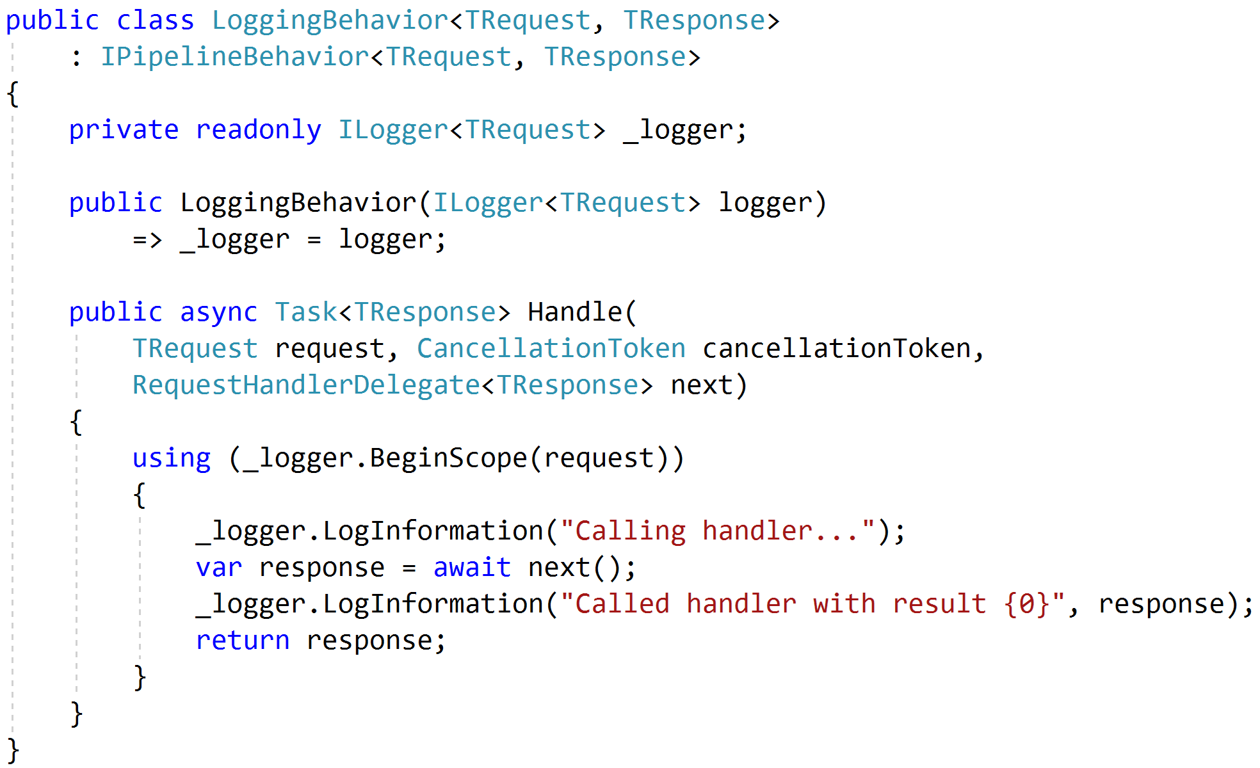
Logging

Slide 72
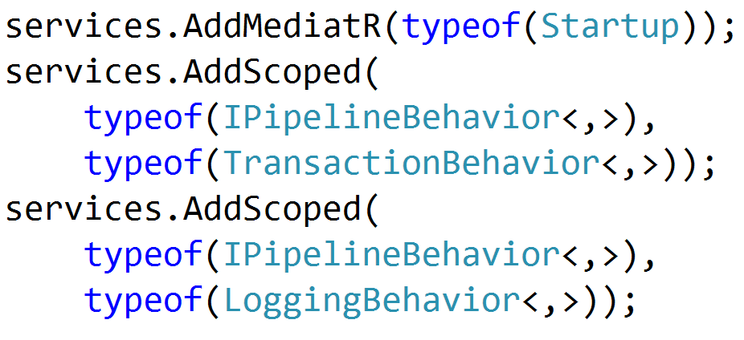

Registration

Slide 73
Testing
Pipeline Behavior
Pipeline Behavior
Pipeline Behavior
Request
Handler
Response
Arrange
Assert
Act

Slide 74
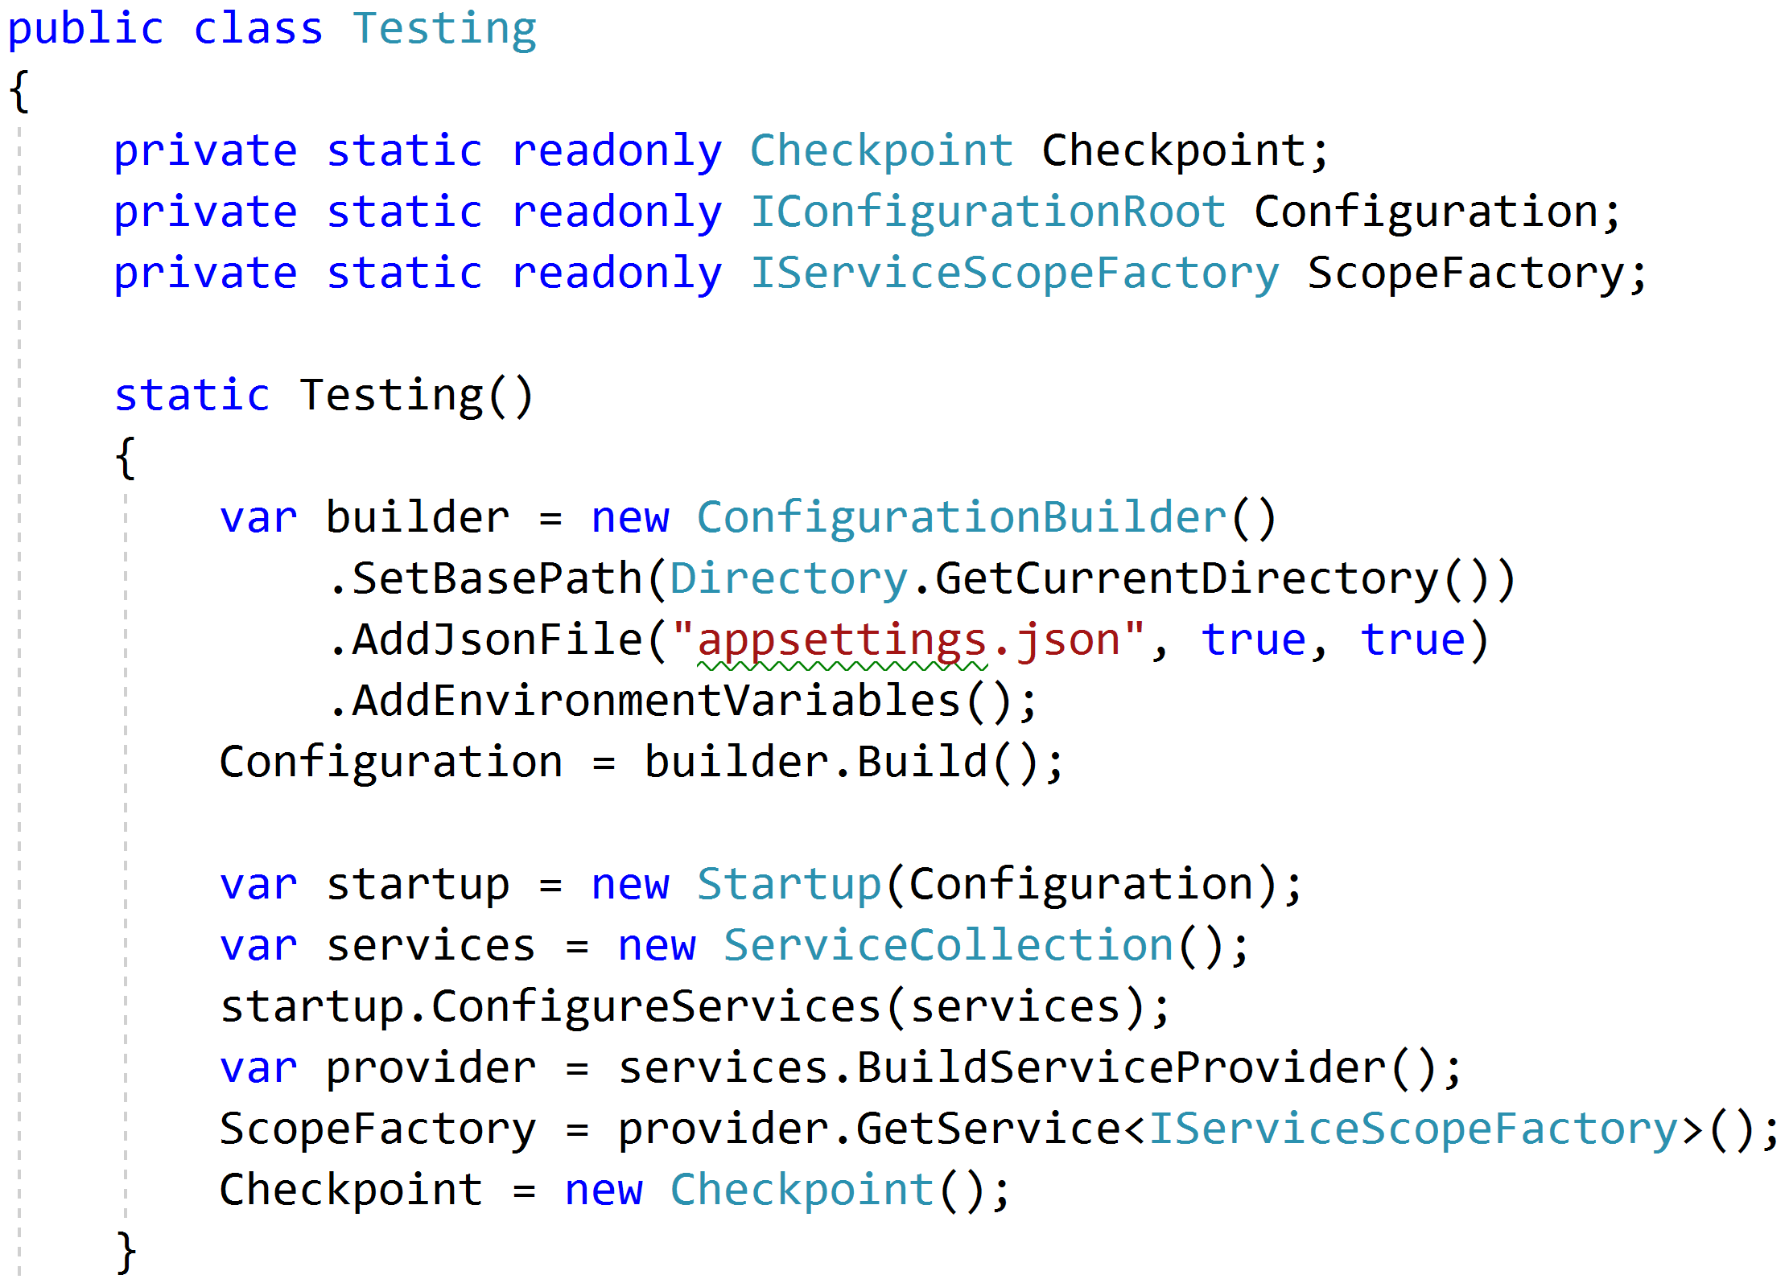
Reproduce Reality

Slide 75
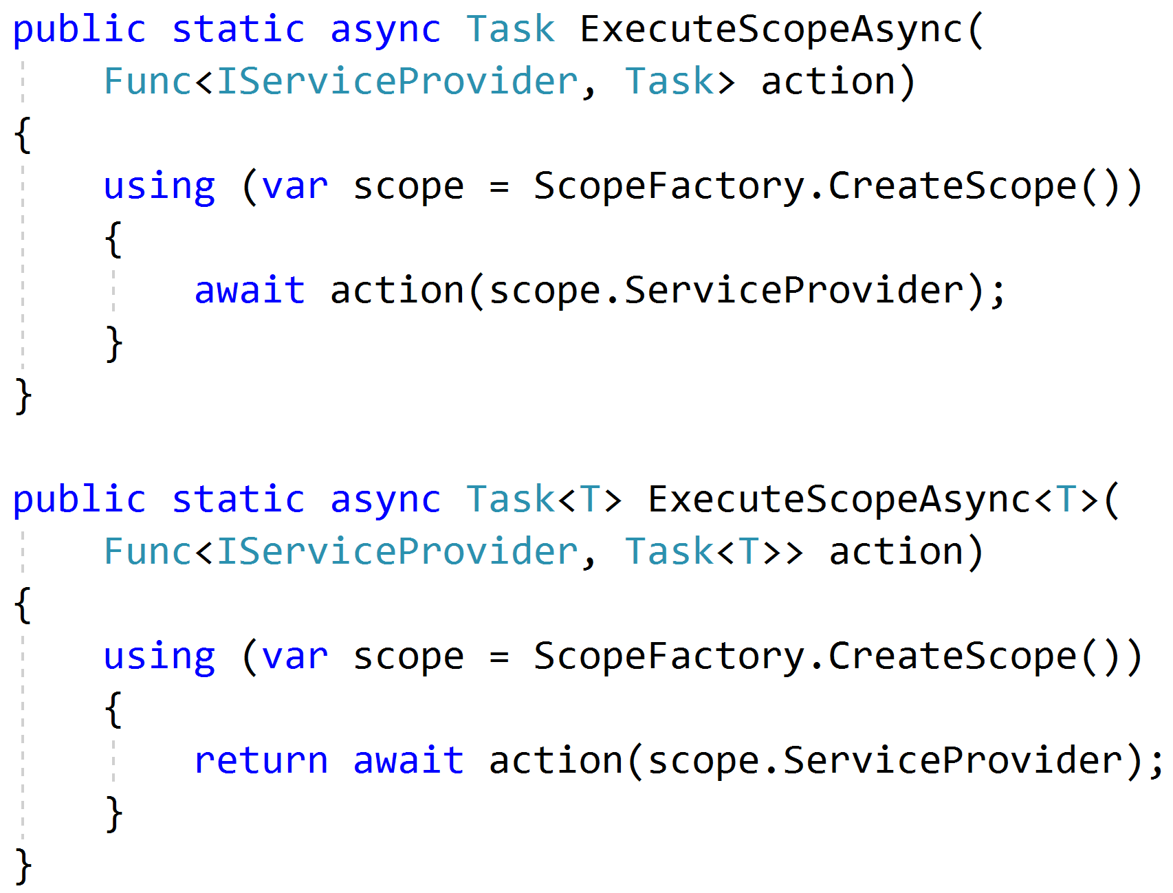
Mimicking Scoped Requests

Slide 76
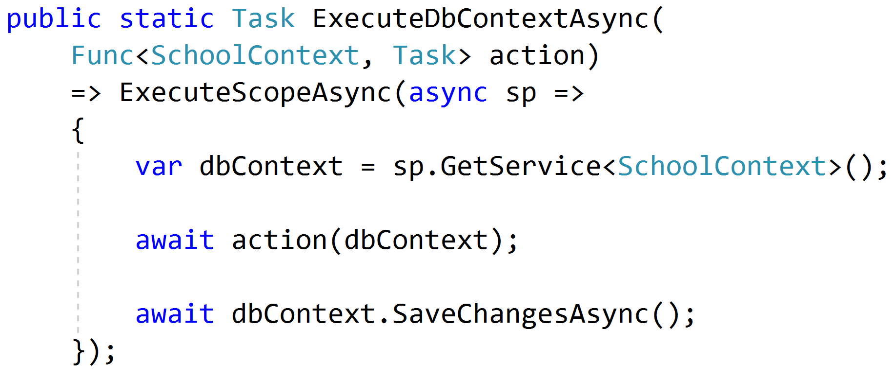
Setting Up Data

Slide 77
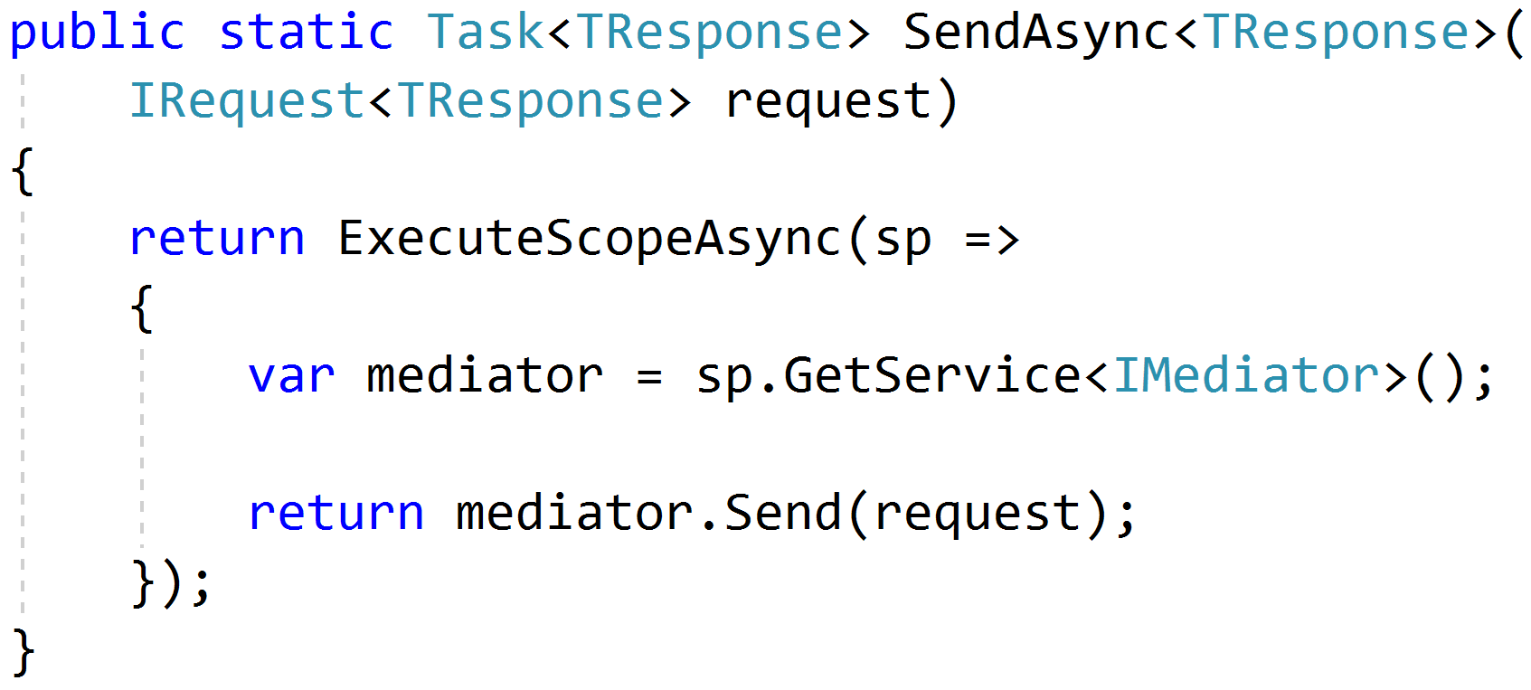
Sending Requests

Slide 78
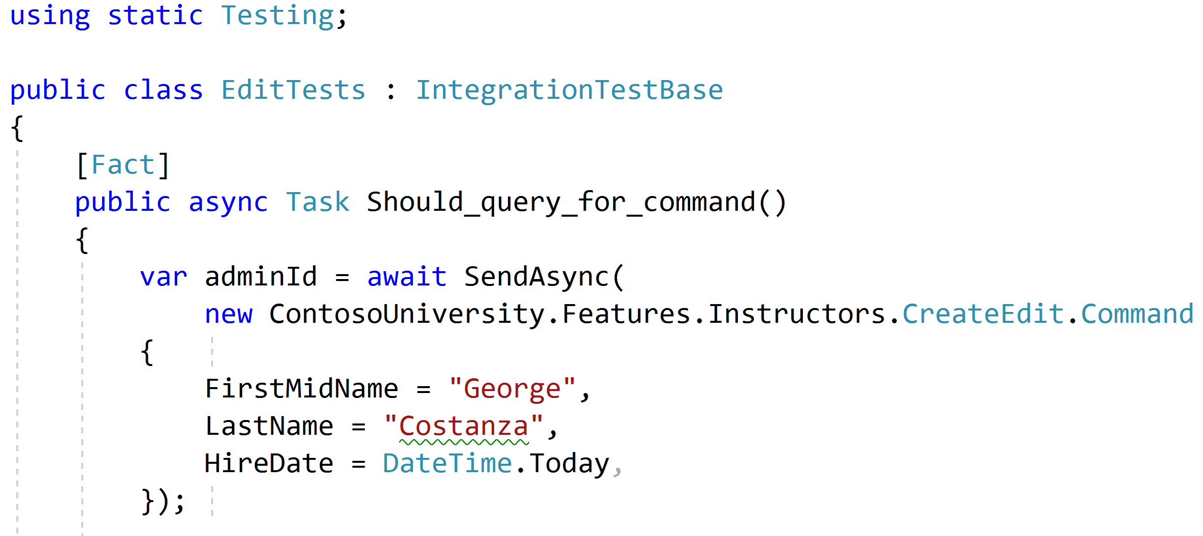
Using static helpers

Slide 79
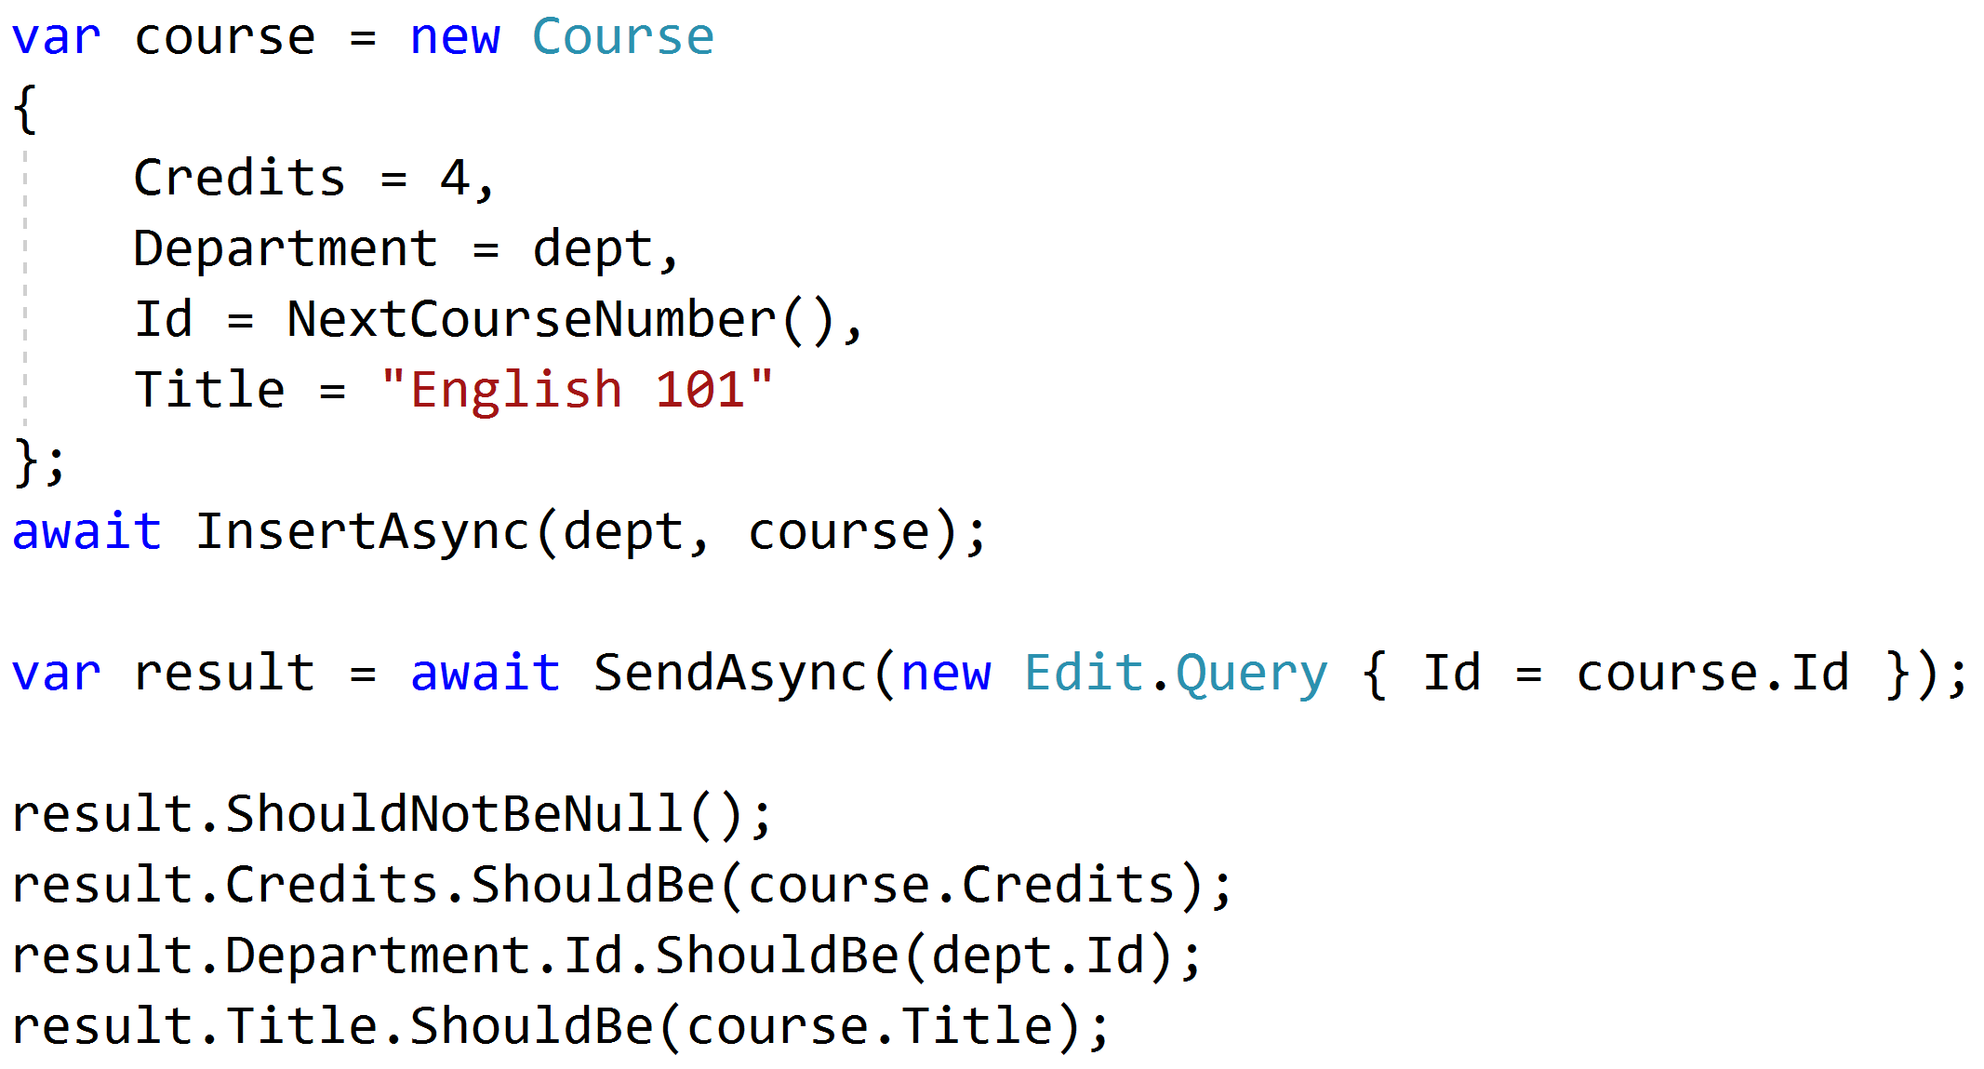
Testing queries through result

Slide 80
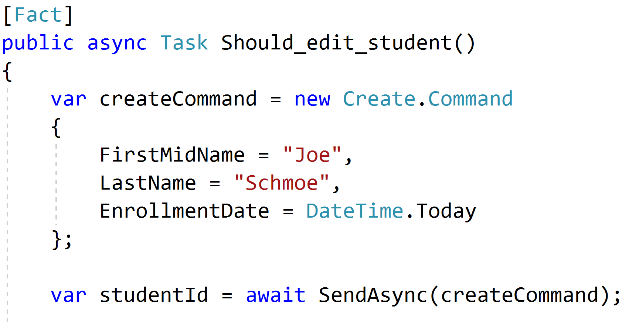
Setup through the front door

Slide 81
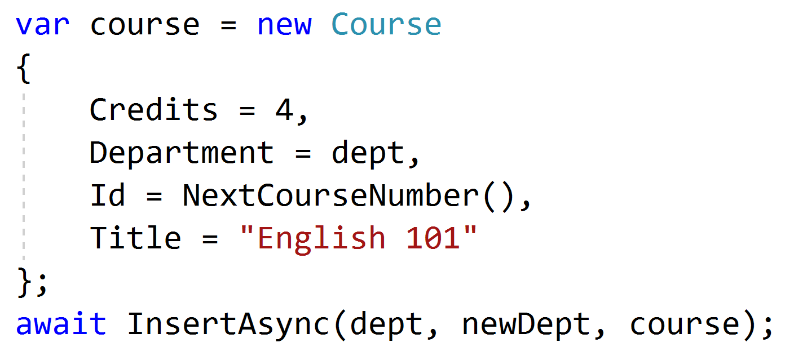
Setup data directly when needed

Slide 82
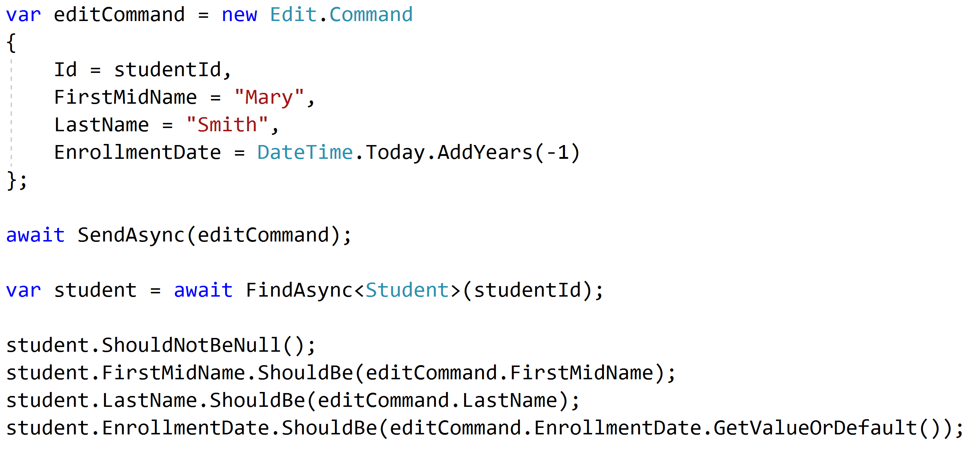
Test commands with roundtrips

Slide 83
Unit and Integration Tests
Pipeline Behavior
Integration Tests
Pipeline Behavior
Pipeline Behavior
Handler
Rich Domain Model
Unit Tests

Slide 84
Key Takeaways
Vertical slices makes code easy to add/change/delete
Do not skip refactor!
Push behavior down
Integration test handlers, unit test domain

Slide 85

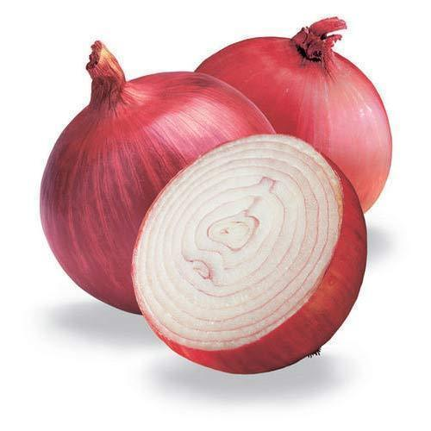
Vertical Slice Architecture
Jimmy Bogard
@jbogard
github.com/jbogard/presentations
jimmybogard.com

